Slide 1
Minecraft Question Answering
David Schulz

Slide 2
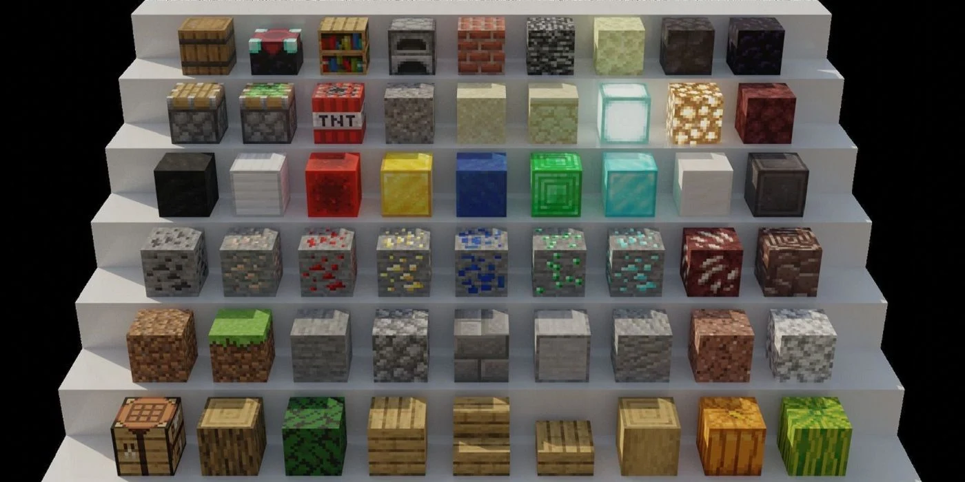
Question Answering
Any question about Minecraft mechanics
Fully and correctly
Blocks, items, mobs, places, gameplay
Example
Category: Mobs
Question: How do I tame a wolf?
Answer: You can tame a wolf by
giving it a bone.

Slide 3
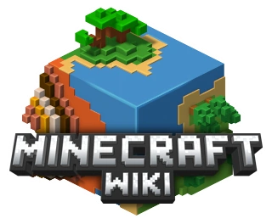
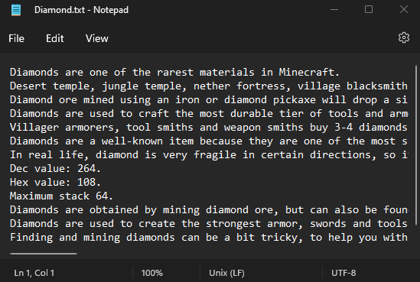
Data
GitHub repo by Corentin Dumont
Scraped knowledge base
1384 text files
Sorted by source/topic
Roughly formatted, image captions
Scraped questions corpus
1030 questions
Sorted by topic

Slide 4
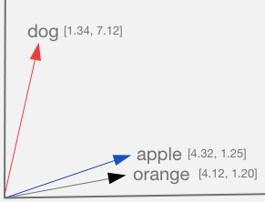
System
Rank keywords in knowledge base by file
Enter category
Enter question
Pick top 3 files
Find keywords from question
Calculate similarity between all sentences
Highest similarity chosen as answer

Slide 5
Demo

